Slide 1
Management of University research grants organized by the faculty research committee 22/03/2022 10 am to 12 noon

Slide 2
Resource persons
Prof Faseeha Noordeen
Chairperson FRC
Prof Kumudu Perera
Department of Biochemistry
Ms WHAD Dilrukshi
Assistant Bursar
Dr Veranja Liyanapathirana
Department of Microbiology
Dr Himani Amaratunga
Secratary FRC

Slide 3
program
Outline of rules and regulations
Troubleshooting and financial matters
Sharing experiences
Question session

Slide 4
Rules and regulations governing University Research grants
Himani Amaratunga
Secretary FRC

Slide 5
eligibility
Only permanent academic staff
One grant at a time as chief investigator
Collaborative studies - purchased equipment, chemicals ect… shall be included in the inventory of the department of the chief investigator
Mandatory to present at the iPURSE

Slide 6
duration
one year from the date of award
Can be extended under special circumstances – no increase in funds
Two year grant scheme – continuous grants

Slide 7
applications
Advertised at the end of the previous year
Closing dates generally in February

Slide 9
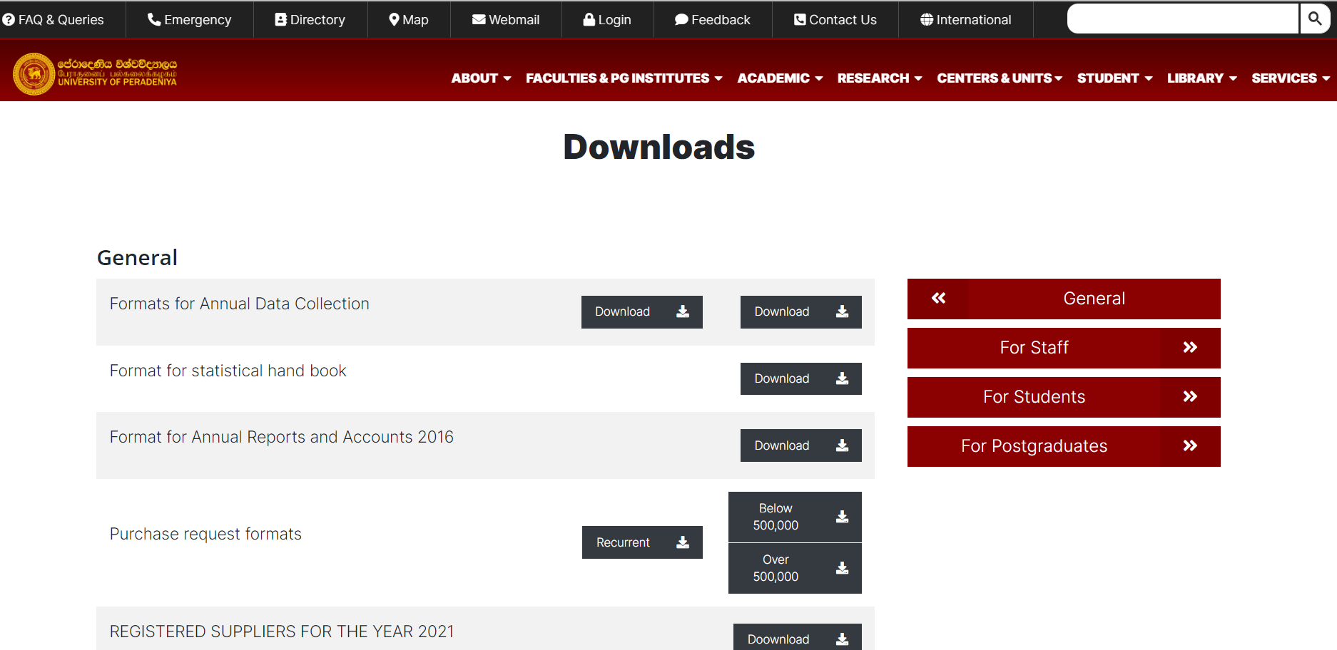

Slide 10
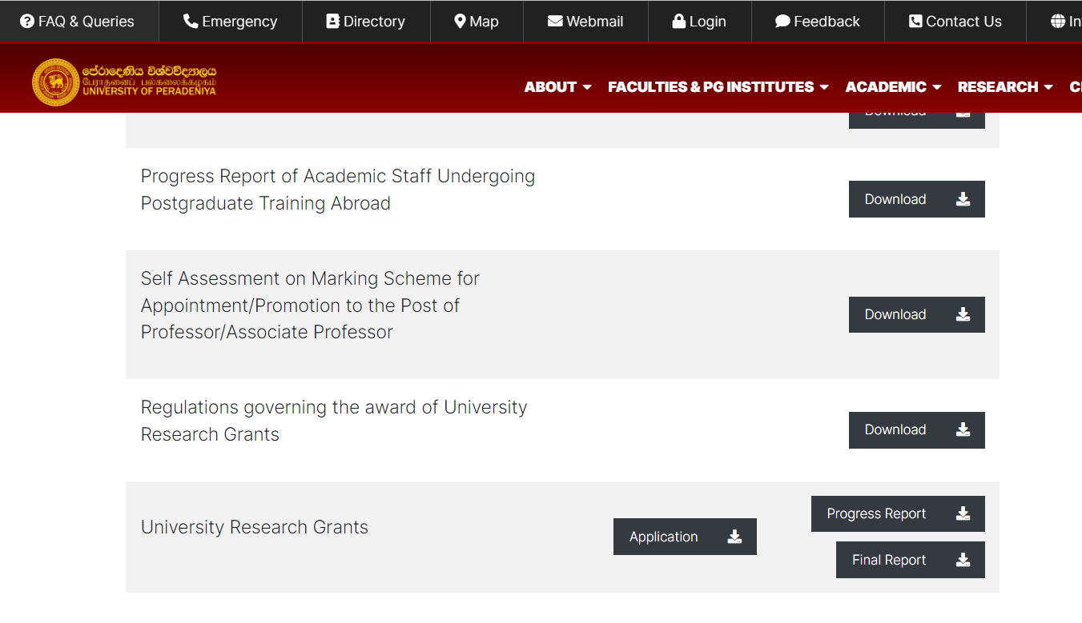

Slide 11
application
Project proposal and budget
Hand over 3 copies under heads signature to shyamali

Slide 12
Processing applications
Assessed at FRC meeting
Sent to reviewers – comments received – back to applicants
FRC meeting to decide the amount of the award
Grant allocation according to frc prioritization scheme
Amount is equally distributed
Priority given to probationary lecturers
Delay in final report submission and request to cancel grants

Slide 13
awarding
SRC shall grant the awards
Grantees will be notified with the effective date
Grantee must accept the grant in writing – through head, frc, dean to vc
Sign an agreement
Funds released in instalments
Progress reports a must!

Slide 14
Can not pay research assistants, over time, subsistence or remuneration for uni staff
But field assistance and laboratory services can be obtained
Local Travelling expenses can be reimbursed – must produce evidence – bills!
Cannot be used for foreign travel!
Books and journals can be purchased – must be handed over to the department upon completion of the grant
Payment vouchers need to go through – head, dean to assistant bursar

Slide 15
Advances can be taken and must be settled within 21 days
Requests for revision of budgetary allocations can be made to the FRC and should be approved by SRC as well
Revisions can be made to the methodology of the project if properly justified – should be informed to FRC and approval sort from FRC and SRC
If outside funds are received for the same project this should be informed to the FRC
Unutilized funds from grants will be returned and allocated for future grants

Slide 16
Progress reports
Six monthly
2 progress reports for the year of award – (June and December if all goes well!)
Should be sent in duplicate through the head of the department to the FRC
Stipulated format
Covering letter
Any publication/conference presentation information can be included

Slide 17
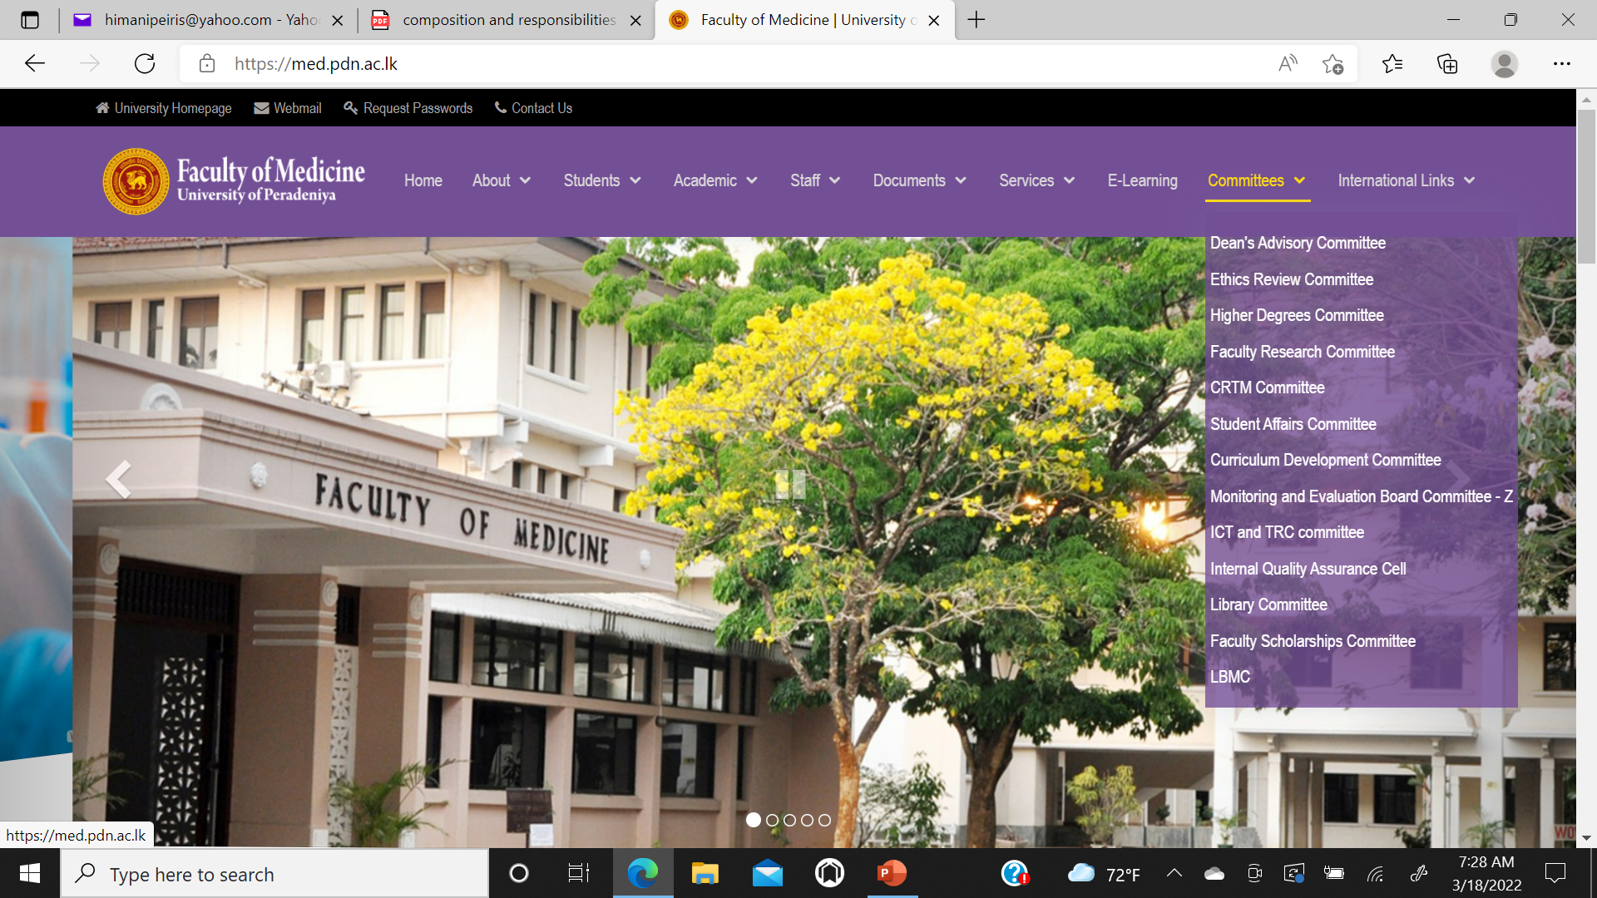

Slide 18
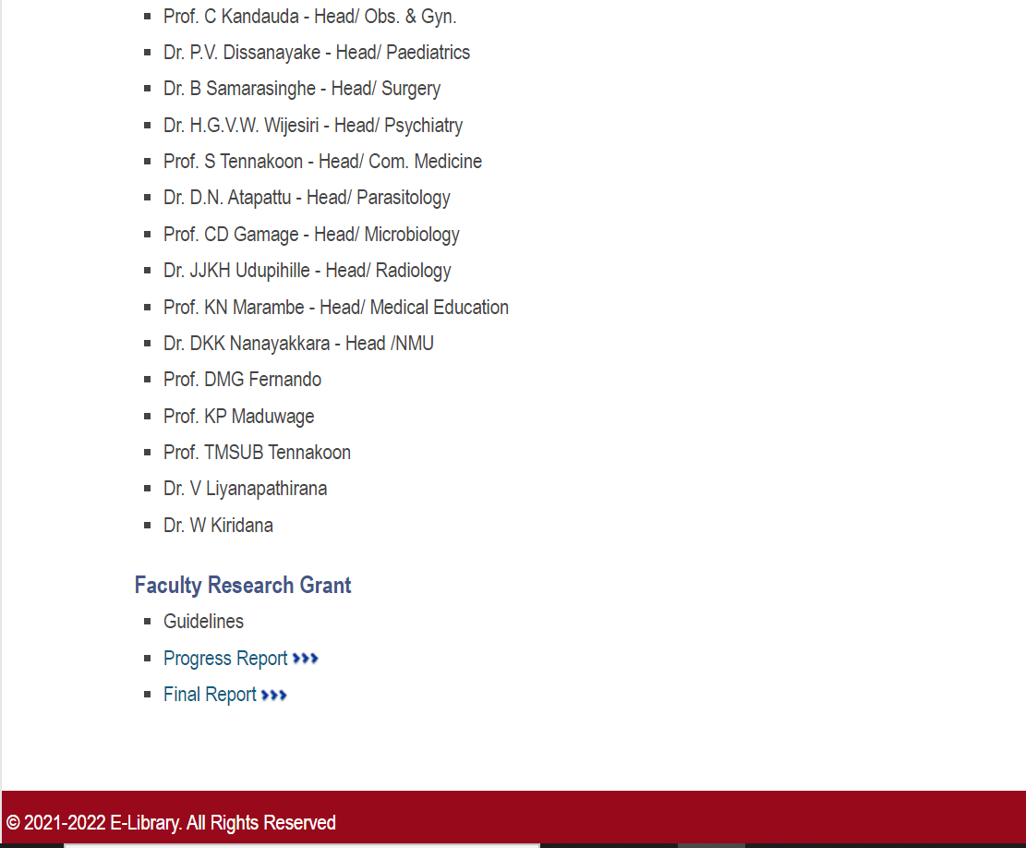

Slide 19
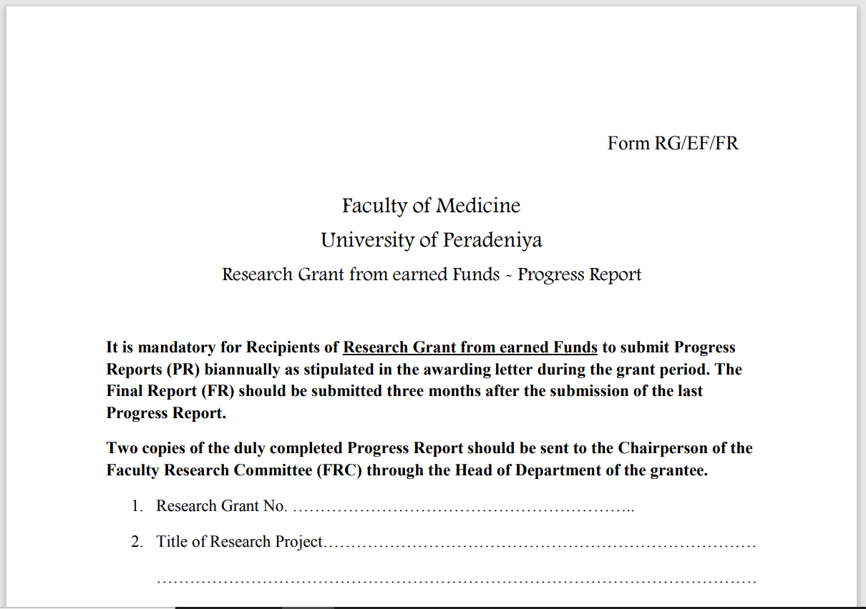

Slide 20
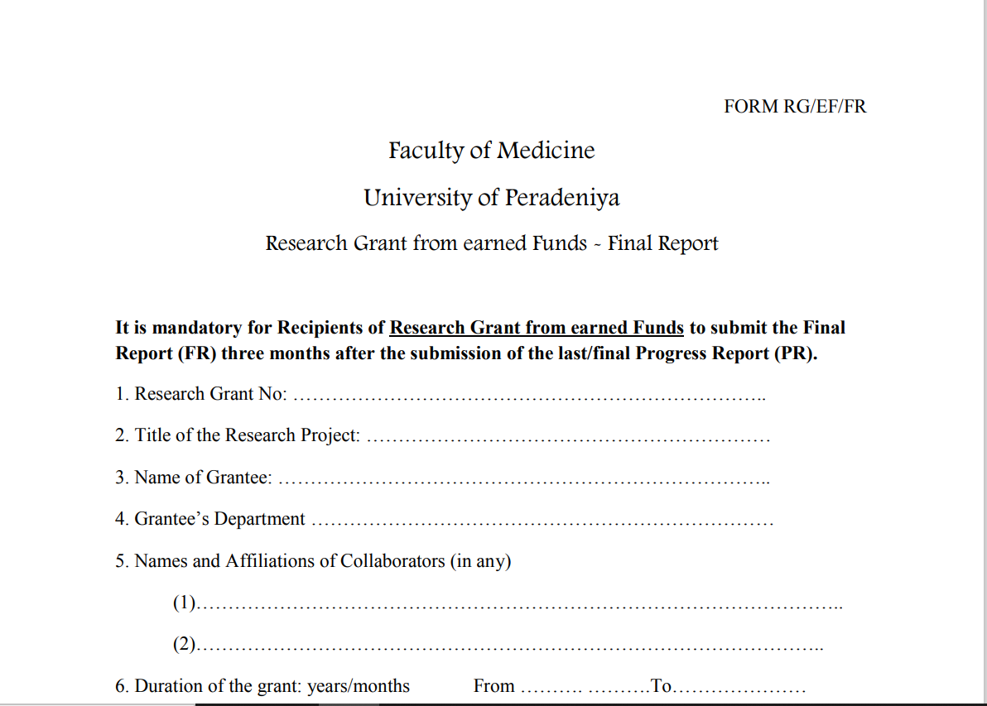

Slide 21
Final report
After completion of the project
Within three months of the last progress report!
Comprehensive report
Stipulated format
In triplicate to the FRC through the head
Covering letter
Publications/conference presentations

Slide 22
Evaluation of progress and final reports
Progress reports will be evaluated by the FRC approved and forwarded to SRC
Final report is a longer process
Internal review by the FRC
Sent to SRC with three nominations – outside experts
SRC selects two outside experts for review
Review reports will be sent to FRC and grantee
Final approval will be given by the SRC according to the reviewer report

Slide 23
Correspondence to SRC should always be through the head, frc chairperson and dean
Financial and administrative regulations of the university
If a grantee is taking leave work on the project must be arranged – grant maybe handed over to another academic for the leave period but the responsibility lies with the grantee
At the end of the projects all advances and financial matters must be settled and all equipment and excess chemicals must be handed over to the department

Slide 24
Delays in submitting progress or final report should be informed to the FRC asap and permission should be sort
Extensions can be obtained – need to be approved by the FRC and SRC
If you are in trouble inform the FRC!
Many provisions are available – make sure to let the FRC know of any delays or problems!

Slide 25
Thank you

